Slide 1
Data Representation
Wednesday, May 25, 2011

Slide 2
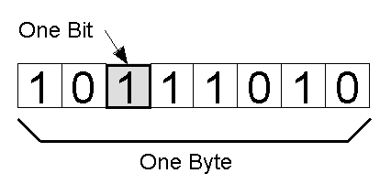
Bits and Bytes
4 bytes = 32 bits → 1 integer = a number up to 4,294,967,296
Notes:
It’s more efficient for the computer to group bits together into groups of 8 (why 8? Was probably just easier to make hardware that supported it when it was decided)
Usually:
1 byte for 1 character
4 bytes for 1 number
Balancing act to decide between:
Using more bytes for a number (bigger numbers, but fewer of them)
Using fewer bytes for a number (smaller numbers, but more of them)
By the way, 10111010 binary = 186 decimal

Slide 3
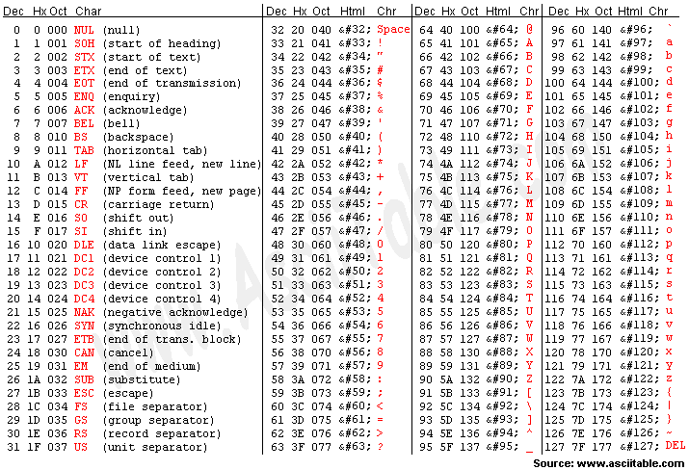
ASCII Code
Notes:
Represent letters by numbers
Start capital A at 65 (or 01000001 in binary) so there is room for special characters in front
Only need one byte to represent the alphabet and special characters found in ASCII
i.e. ASCII characters use one byte of storage each

Slide 4
ASCII Code

Slide 5
Text Compression
The Rain
Pitter patter
Pitter patter
Listen to the rain
Pitter patter
Pitter patter
On the window pane
Notes:
CS Unplugged activity on text compression
http://csunplugged.org/sites/default/files/activity_pdfs_full/unplugged-03-text_compression.pdf
What letters or words are repeated in this poem?

Slide 6
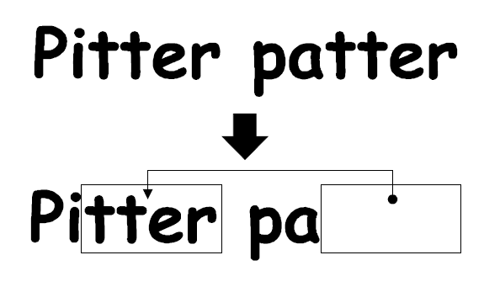
Text Compression
Notes:
Draw boxes around the first occurrence of a set of letters (two or more), then don’t repeat those letters; just draw an arrow to the original

Slide 7
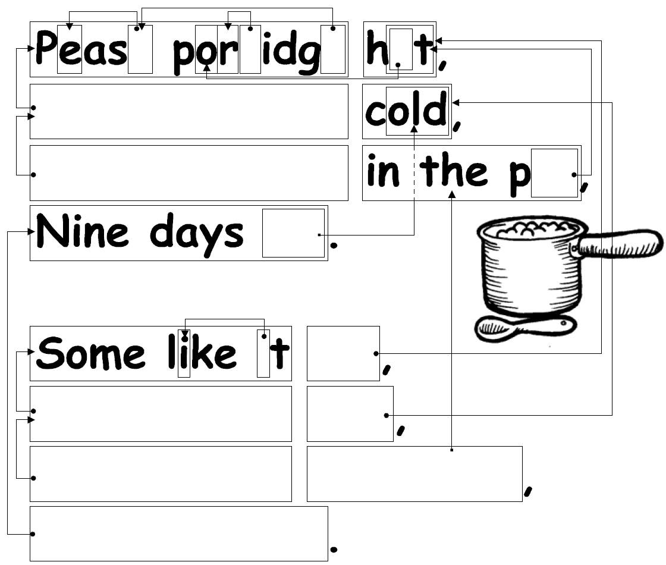
Text Compression
Notes:
Solution:
Pease porridge hot,
Pease porridge cold,
Pease porridge in the pot,
Nine days old.
Some like it hot,
Some like it cold,
Some like it in the pot,
Nine days old.

Slide 8

Text Compression
Notes:
Answer: Banana

Slide 9
Babbage's Difference Engine
http://www.youtube.com/watch?v=0anIyVGeWOI

Slide 10
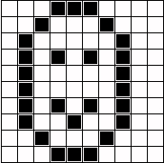
Raster/Bitmap Graphics
Notes:
Draw a picture in the spaces of a grid
Lower resolution images have fewer pieces in the grid to fill in

Slide 11
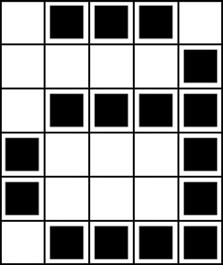
Colour by Numbers
a
Notes:
CS Unplugged Activity: Colour by Numbers: Image Representation
How might we represent the raster image of the ‘a’ on the computer?
One way is to simply list each pixel’s value using binary digits
For instance, black could be a 1 and white could be 0
Then the image here would be:
01110
00001
01111
10001
10001
01111
You could even just list all these numbers in one big long row if you knew the number of rows and columns in the image ahead of time

Slide 12
Colour by Numbers
1,3,1
4,1
1,4
0,1,3,1
0,1,3,1
1,4
Notes:
CS Unplugged Activity: Colour by Numbers: Image Representation
http://csunplugged.org/image-representation
Instead of listing every pixel we can just say how many whites or blacks there are in a row (now using regular decimal numbers instead of binary digits)
Compare this method to the “describe every pixel” method

Slide 13
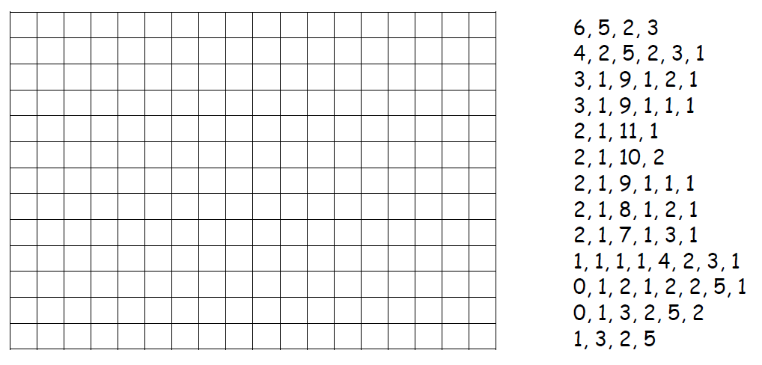

Slide 14
Colour by Numbers
Pros and cons of this approach?
Notes:
CS Unplugged Activity: Colour by Numbers: Image Representation
Pros:
Don’t need to write out every little pixel
Usually takes less space since most images have a lot of repetition
Cons:
When transmitting data something might get lost
Losing one number might affect the image a lot more than if every pixel is described

Slide 15
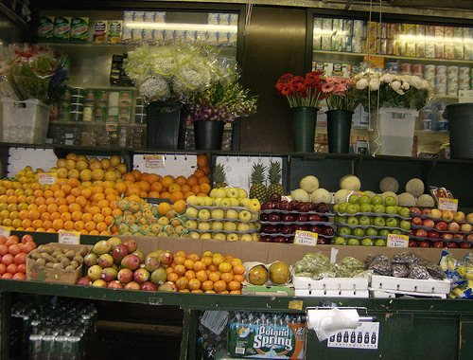
Raster/Bitmap Graphics
Notes:
Each piece (or pixel) in the grid might be black or white, so just one bit per pixel
If want more shades of gray, can use a whole byte per pixel
1 byte = 8 bits = numbers up to 255 -> 255 shades of gray
Colour photos:
Three colours – red, green, blue
How much of each colour?
Use one byte per colour = 3 bytes per pixel
Photographs are an example of a raster (aka bitmap) graphic
Digital cameras have a sensor laid out, more or less, like a grid
Light hits the pieces of the grid and is recorded
More megapixels = more pixels in the grid

Slide 16

Vector Graphics
http://conichiwua.files.wordpress.com/2006/10/bottle_completa.png
Notes:
Vector graphics are made of individual shapes and curves
Mathematical expressions define how the shapes and curves will look
Properties such as fill and outline colour/thickness can be defined
They allow you to zoom in or stretch the image as much as you want without degrading the quality
Just redo the math to figure out what to display in terms of what is currently visible

Slide 17
The Difference
Two versions of the same image.
One is a raster image, the other vector.
Notes:
Which format (vector or raster) would take less space?
Depends…
A raster image will always require a fixed number of pixels
A vector image’s size will be determined by how many shapes etc there are and how complex they are
When would you want to use vector? When raster?
Think about the content of the image and how/where it would be displayed

Slide 18

Intro to 3D Graphics
Notes:
Video introducing what 3D graphics are
http://video.google.com/videoplay?docid=-5705559709668742546&q=intro+to+3d+graphics&ei=LxMhSMSpMY6y-wGStNDAAQ

Slide 19
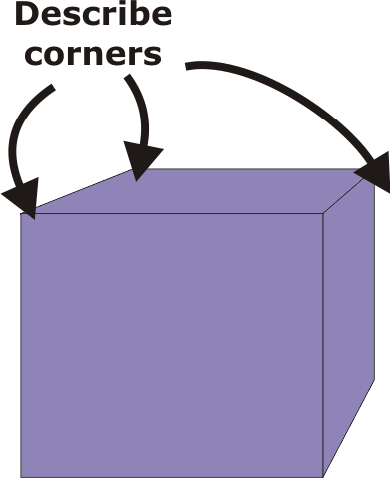
Mathematical 3D Objects
Notes:
Shapes in 3D graphics are defined by giving the locations of all their key points in 3D space, and how they are connected
Curves require more complex information

Slide 20
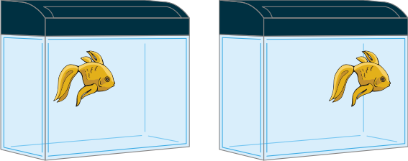
Translation
Notes:
The basic shapes can be manipulated
For example, they can be translated, or simply moved

Slide 21
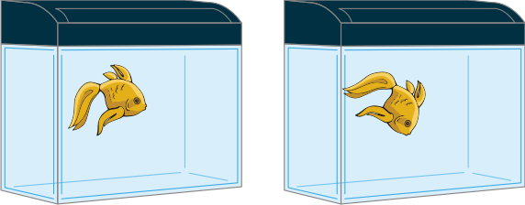
Rotation
Notes:
- Rotation can occur around any axis in three dimensions

Slide 22
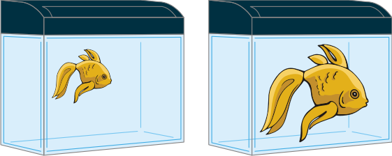
Scaling
Notes:
Scaling is simply changing the size; this is possible because the shapes are defined like vector graphics
Other transformations are possible, and they can all be combined in various ways

Slide 23
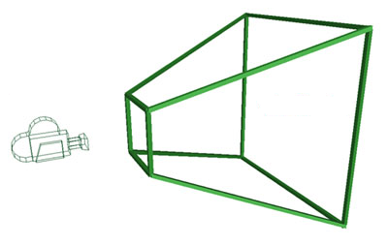
3D Games Have to Deal With:
How much can the camera see?
http://www.chadvernon.com/blog/wp-content/uploads/2007/07/frustum.jpg

Slide 24
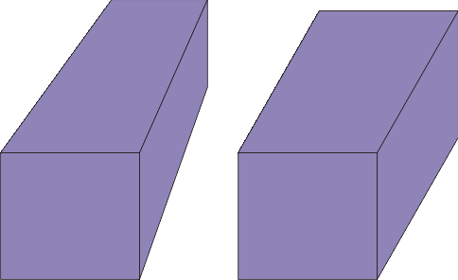
3D Games Have to Deal With:
Should objects further away look smaller?

Slide 25
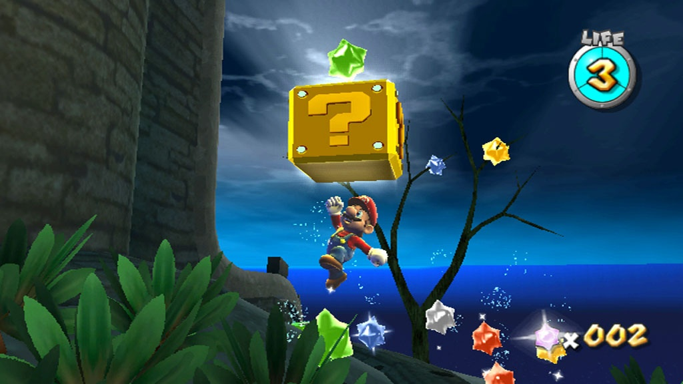
3D Games Have to Deal With:
Should objects further away look smaller?
YES
http://o.aolcdn.com/gd-media/games/super-mario-galaxy/wii/93.jpg

Slide 26
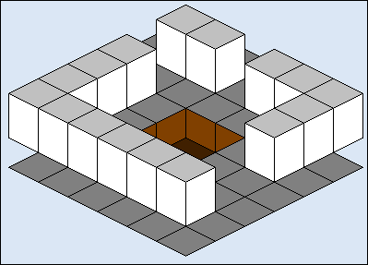
3D Games Have to Deal With:
Should objects further away look smaller?
NO
http://www.codeguru.com/dbfiles/get_image.php?id=10123&lbl=3DPROJ04_GIF&ds=20061023

Slide 27

Let’s See Graphics in Action!
“Big Buck Bunny”
Movie created entirely by free, open source tools
http://www.bigbuckbunny.org/
Notes:
When watching this video, think about what sort of issues have to be dealt with in terms of 3D graphics
What kinds of things do you think would be particularly challenging?
Note that this video was made with 100% free software that you can try out for yourself
http://www.blender.org

